Slide 1
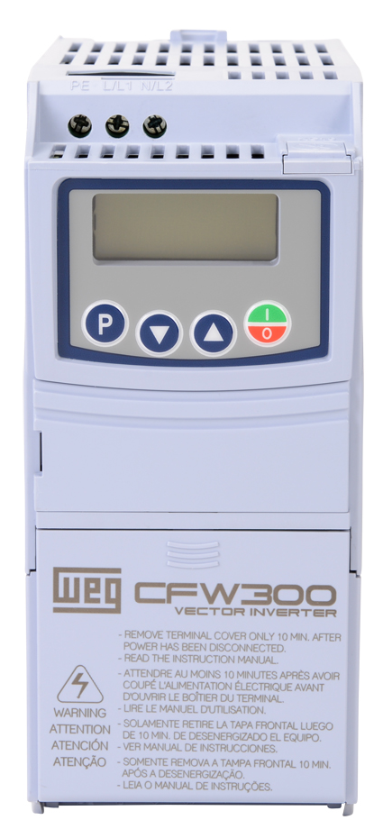
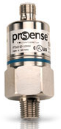
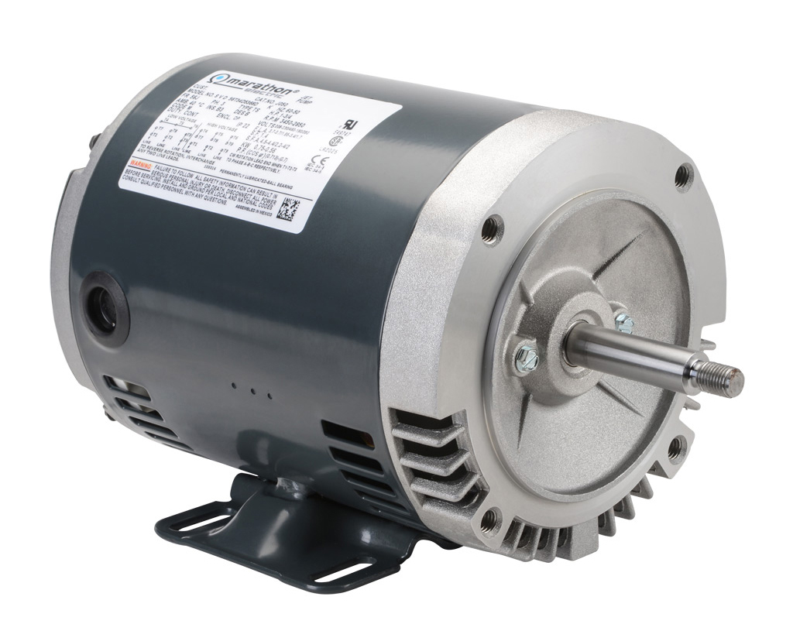
CFW300 VFD PID Test Station Wiring/Block Dia.
(For System Pressure Example)
0-15 psig Pressure Sensor (0-10 VDC)
PTD25-10-0015H
PSI
(0-10 VDC)
120 VAC
AI1
0-10 VDC
QD Cable, PN:CD12M-0B-070-C1
Disconnect
Breaker
24Vdc
PUMP
Hayward Pool Pump
DI1
Run/Stop
Man/Auto
DI2
Jet Pump Motor
1hp 3450 rpm
PN: J050
com
Check
Valve
Shields
Reservoir
WEG CFW300 1 hp VFD
PN: CFW300A04P2S1NB20

Slide 2
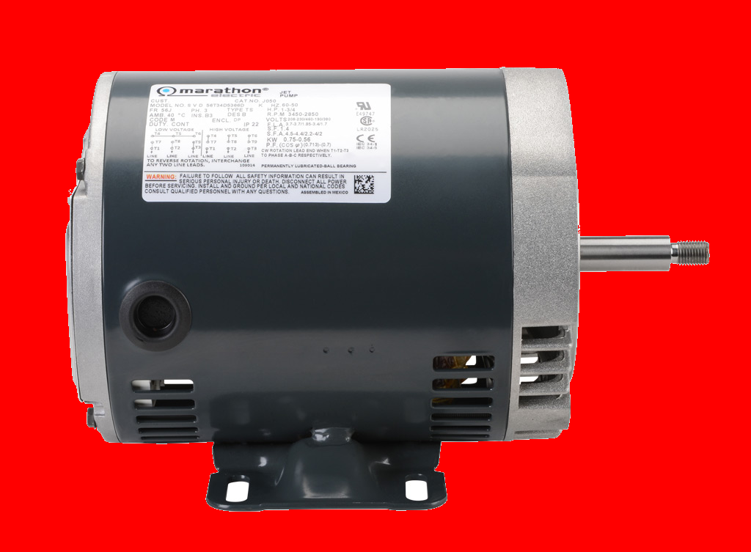
CFW300 VFD PID Test Station Wiring Diagram
PN: PTD25-10-0015H
QD Cable, PN:CD12M-0B-070-C1
Pressure
Transducer
0-10 VDC
L
N
PSI
Meter
RUN/STOP
PE
L1
L2
L3
PN: DPM3-AT-L
1
DI1
2
DI2
PN: J050
AUTO/MAN
3
DI3
DRIVE
PN: CFW300A04P2S1NB20
PN: GCX-1300
4
DI4
5
GND
Process
6
AI1 (I)
7
GND
8
AI1 (V)
9
GND
10
AI1
24 VDC
11
GND
W
V
U
PE
12
AI1
PE
U
V
W

